Slide 1
Distributed Computer Systems
CT024-3-3-DCOMS and VE
Socket Programming

Slide 2
TOPIC LEARNING OUTCOMES
At the end of this topic, you should be able to:
•Understand Socket Programming

Slide 3
Teaching Contents
Socket Programming
Introduction
Working Principle
Implementation

Slide 4
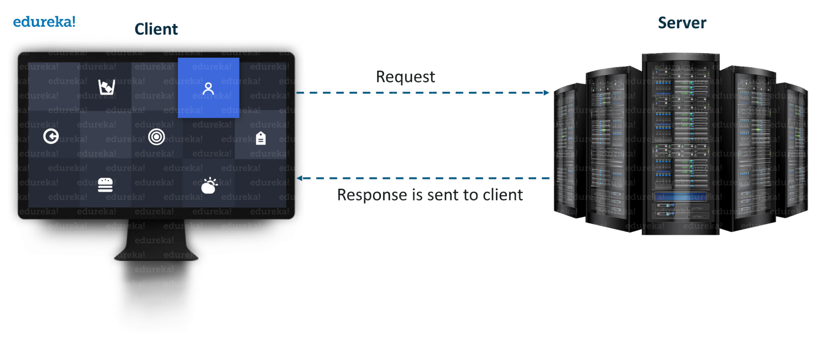
What is Socket Programming?
Java Socket programming is used for communication between the applications running on different devices.

Slide 5
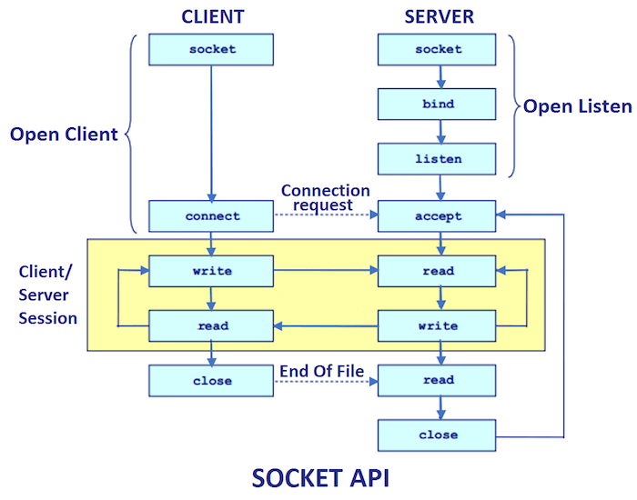
Socket Programming- Working Principle

Slide 6
Socket Programming- Working Principle
In socket programming, there are two types of sockets: server sockets and client sockets. The server socket listens for incoming connections from clients, while the client socket initiates a connection to the server. Here are the basic steps involved in socket programming:
Create a socket: In your programming language of choice (such as Python or Java), you create a socket object that represents a network endpoint. The socket object can be either a server socket or a client socket.
2.Bind (for servers): If you're creating a server application, you need to bind the server socket to a specific IP address and port number on the machine where the server is running. This allows the server socket to listen for incoming connections on that address and port.
3.Listen (for servers): After binding, the server socket enters a listening state, waiting for incoming connection requests from clients.

Slide 7
Socket Programming- Working Principle
4.Connect (for clients): If you're creating a client application, you need to connect the client socket to the IP address and port number of the server to which you want to connect.
5.Accept (for servers): When a client attempts to connect to the server, the server socket accepts the connection request, creating a new socket specifically for that client. This new socket is used for communication with the client.
6.Send and receive data: Once the connection is established, both the client and server sockets can send and receive data using methods or functions provided by the socket library. Data can be sent in the form of bytes or encoded strings.
7.Close the sockets: After communication is complete, both the client and server sockets should be closed to release the resources. Closing the socket terminates the connection.

Slide 8
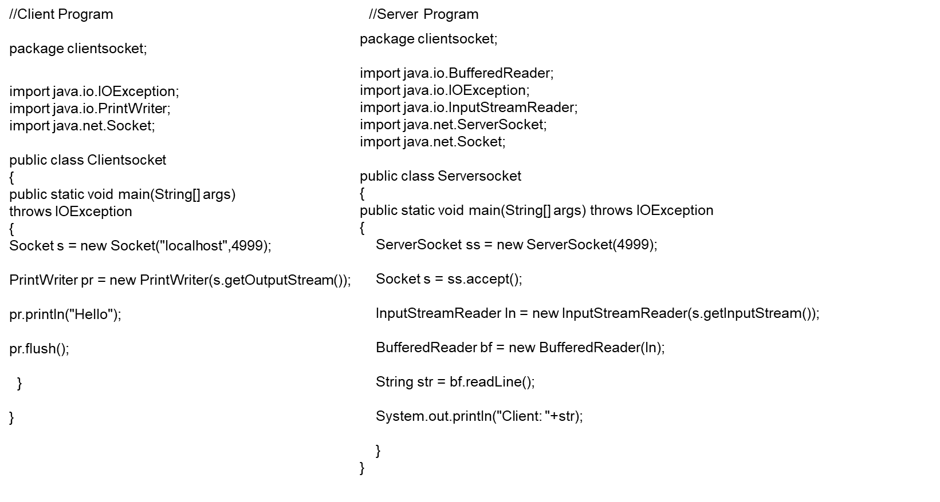
Socket Programming- Implementation

Slide 9
Review Questions
What is Socket Programming?
Briefly outline the working principle of Socket programming.

Slide 10
Summary / Recap of Main Points
Introduction to Socket Programming
Working Principle
Implementation

Slide 11
What To Expect Next Week
In Class
Multithreading

